Slide 1
Store, Manage, and Archive Content in the Cloud
Michele Kimpton, DuraSpace
CEO DuraSpace
Nate Klingenstein, Internet 2
Internet 2 meeting, April 2013
Notes:
Today we have 3 panelists whom are all using duracloud for archiving and preservation. These institutions have three distinct systems they are pushing content from to archive in duracloud, they are in different phases of implementing a preservation strategy, and have different needs as a result. Each panelist will share with you evaluation process, preservation strategy and reasoning for choosing duracloud at this time.

Slide 2
Timeline
April 2012 began discussions
Sept 2012 signed agreement
Oct 2012 started validation process with:
U of Virginia
North Carolina State University
U of Michigan
April 2013 service validation complete-GA
Shibboleth integration, Incommon authentication
Business Agreement
Validate offering
Notes:
Give you some of the histroy of our path to becoming a netplus provider, we are a not for profit and support and develop community sourced solutions.

Slide 3
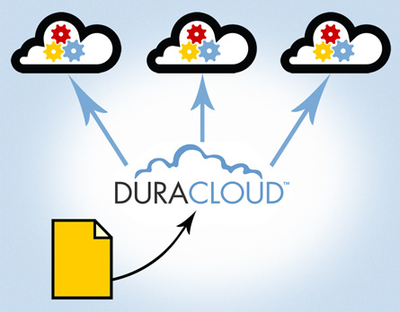
What is DuraCloud?
Archiving and preservation services in the cloud
Ability to choose one or multiple cloud storage providers
S3 and Glacier
SDSC
Rackspace

Slide 4
What does DuraCloud do?
Online backups
File health checking
File synchronization and healing
Online sharing
Media streaming
Image serving

Slide 5
How can DuraCloud help me with my archiving and preservation strategy?
Ability to easily move online copies offsite, distribute geographically
Easily check the health of all copies
Easily repair or replace corrupted files
Easily move or download content from multiple providers
Scale storage up or down as needed
Full Web access with ability to view/edit/delete and upload/download your content

Slide 6
Why should you care?
Government mandates in place to provide long term access to content well after the grant period
Contractual obligations for managing content
Ever increasing amounts of digital content and digital data that needs to be archived

Slide 7
Cost
$100-$1,000 per TB/yr
Annual basic subscription fee $500/yr
No I/O cost
No data transfer costs
Can pay as you go, or annual contract to lock in cost

Slide 8
Report by MHS, April 2013 http://www.mnhs.org/preserve/records/specialprojects.htm

Slide 9
What users are saying
“The ease-of-use of DuraCloud is its most impressive feature.” ~Columbia
“DuraCloud delivers the benefits of a diverse network of storage locations, but without the overhead of managing different vendors.” ~ICPSR
DuraCloud provides a robust infrastructure to support digital preservation of content in our institutional repository, along with services that enhance the delivery and integrity of the content."
~Geneva Henry, Rice University

Slide 10
In production for one year
Some stats-
35 TB of data
25+ institutions using Duracloud as a service
100% Durability, no file failures
5.46 million items stored
60+ identified file types

Slide 11
DuraCloud Roadmap
Coming in 2013
Glacier integration
Shibboleth integration
Search
Encryption services
Other cloud based offerings
Dspacedirect( hosted repository service)

Slide 12
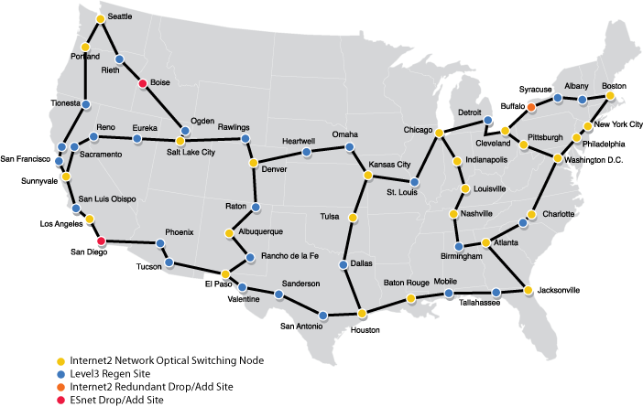
Our Goal, run DuraCloud platform on academic cloud infrastructure
Duracloud
Duracloud
Duracloud
Duracloud
Duracloud

Slide 13
To find out more
Web:
http://www.internet2.edu/netplus/duracloud/index.html
Documentation:
http://wiki.duraspace/display/duracloud
Webinars and Training Videos:
http://www.youtube.com/user/duracloudvideos
Email:
csmith@duraspace.org or mkimpton@duraspace.org

