Slide 1
An Introduction to DuraCloud
Michele Kimpton, Project Director
Carissa Smith, Partner Specialist
DuraSpace Webinar  Sept 2011
Notes:
Today we will be talking about the features and functionality associated with the managed service. DuraCloud software is open source, so if you choose you can run it yourself. We will not talk about the OSS and architecture today however. Joined by Carissa Smith- actual demo

Slide 2
Who are we?

Slide 3
Why cloud?
A style of computing where massively scalable IT-related capabilities are provided “as a service” using Internet technologies to multiple external customers. (Gartner 6/08)
Notes:
Easy access to scalable infrastructure
Goal was to build a cloud based platform, that would allow our community to use cloud infrastucture for some of the more challenging tasks- in association with stewarding content

Slide 4
DuraCloud Project History
Release 0.5 Open Source
Release
07/2010
.9 release
Beta production
06/2011
Release 0.1 Cloud Storage Mediation
11/2009
.7 release
Bulk services
12/2010
Service Public Lauch
10/2011
Release 0.3
05/2010
10/2009
Initial Pilot Program Begins
02/2010
Release 0.2
Service Infrastructure
06/2010
Release 0.4
Media Streaming
08/2011
Release 1.0
09/2010
Second Pilot program starts
Notes:
10 releases of the software and ran 2 pilot programs- engaging with 15 partners total to help test the sofware and provide feedback

Slide 5
Phase 2 Pilot Partners
University | Use Case | Repository
Rice U | Preservation | DSpace, meta archive
Hamilton College | Access/international collaboration | Fedora
Northwestern U | Preservation books, audio, image | Fedora
U of PEI | Image access | Fedora/Islandora
ICPSR | Preservation | Fedora
IUPUI | Preservation | DSpace, Content DM
Rhodes College | Image Access | DSpace
North Carolina State U | Preservation | DSpace
CARL | Preservation and Services | Fedora
MIT | Preservation | Dspace
Columbia | Preservation and Services | IA, Fedora

Slide 6
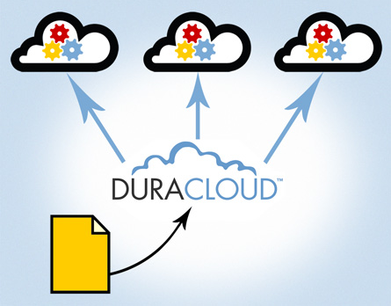
What is DuraCloud?
Open technology and managed service that utilizes cloud infrastructure for preservation support and access services
Upload once and make multiple copies to various storage providers
Access anywhere from any Internet connected device

Slide 7
How does DuraCloud work?
Rackspace
YourDuracloud.org
Virtual server
Amazon S3
(primary)
Your Content
Transfer Content via:
- Web User Interface
- Sync Utility
-- REST API
Azure (beta)

Slide 8
Features
Simple: upload once and make multiple copies to various storage providers
Hosted Service: web-enabled, no client software needed
Fully managed solution: one unified interface across multiple providers
Flexible: built on highly scalable cloud platform
Turnkey services: preservation support and media access
Open source platform

Slide 9
DuraCloud services
Archiving and Preservation
Multimedia Access
Online Backup(s) and synchronization
Advanced Image Viewing
File Format
Identification
Media Streaming
Bit Integrity Checking
Image Transformation
Duplicate and change on Demand
…more on the roadmap

Slide 10
Repository software integrations
DuraCloud is integrated with Fedora and DSpace repository platforms
Islandora, OJS in process

Slide 11
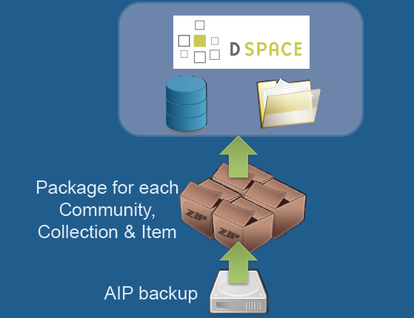
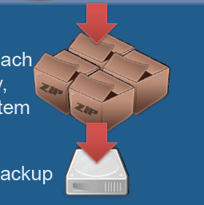
Use case: digital archiving
Use Cases:
-Retrieval of lost files (admin error)
-Replacement of damaged files
-Partial/Full disaster recovery
Preservation services:
-monitoring
-file retrieval
-access
-integrity checking
-replication

Slide 12
Use case: file/collection retrieval
Use Cases:
-Retrieval of lost files (admin error)
-Replacement of damaged files
-Partial/Full disaster recovery
Preservation services:
-monitoring
-file retrieval
-access
-integrity checking
-replication

Slide 13
How can DuraCloud help me?
Ability to easily move online copies offsite, distribute geographically
Easily check health of remote online copies
Easily replace deleted, corrupted or lost files
Scale storage up or down as needed
Full Web access with ability to view/edit/delete and upload/download your content
Ability to stream video files and embed into local applications
Provide access to content through simple http link if desired

Slide 14
Pilot partner comments
“The ease-of-use of DuraCloud is its most impressive feature.” ~Columbia
“DuraCloud delivers the benefits of a diverse network of storage locations, but without the overhead of managing different vendors.” ~ICPSR
“One of the best things that DuraCloud does is bridge the complex gap between normal users and cloud-based services, and it does this job very well.” ~Rhodes College

Slide 15
Pricing
Service Plan | Basic archiving | Basic media access | Professional
Monthly subscription fee | $375 | $375 | $599
Number of accts | 5 | 5 | 20
Free storage | 500 GB | 500 GB | 1000 GB
Services | archiving | media | all
Additional storage | NA | NA | $.086-$.125 per GB*
* Varies by storage provider, up to 50 TB
Annual invoices also available

Slide 16
What does the fee cover?
Management and servicing of the DuraCloud software
Your own hosted instance of Duracloud
Access to all services offered in Duracloud
Complimentary software upgrades
Single Web console for account management
One invoice from DuraSpace- annual or monthly
Basic technical support

Slide 17
Commercial Cloud Vendors vs. DuraCloud
Features | Commercial Cloud Vendors | DuraCloud
Online backup | ✔ | ✔
Web access | ✔ | ✔
Ability to transfer content via web | ✔ | ✔
Online Sharing | ✔ | ✔
Media Streaming | ✔ | ✔
Integrated management console |  | ✔
File health checkup |  | ✔
Ability to copy content to multiple cloud providers |  | ✔
Advanced image viewing |  | ✔
Image Transformation |  | ✔
Open source software |  | ✔
Community-share platform |  | ✔

Slide 18
On the roadmap
Services
Improved video handling
Search
File validation
DSpace as a service application
Storage providers
Chronopolis (UCSD)
Azure
Local Eucalyptus integration

Slide 19
The open source platform
Available for organizations to run locally
Requires cloud ( commercial or private) infrastructure
Being tested by several organizations now
Looking for organizations that want to enable their “software as a service” in DuraCloud
For more details visit the wiki at:
https://wiki.duraspace.org/display/duracloud/

Slide 20
Upcoming Webinars
Using DuraCloud for Archiving and Preservation October 26 at 1pm ET
Technical Overview of DuraCloud November day/time TBA
DSpace and DuraCloud
Fedora and DuraCloud November/December days/times TBA

Slide 21
Free DuraCloud Trial Accounts

Slide 22
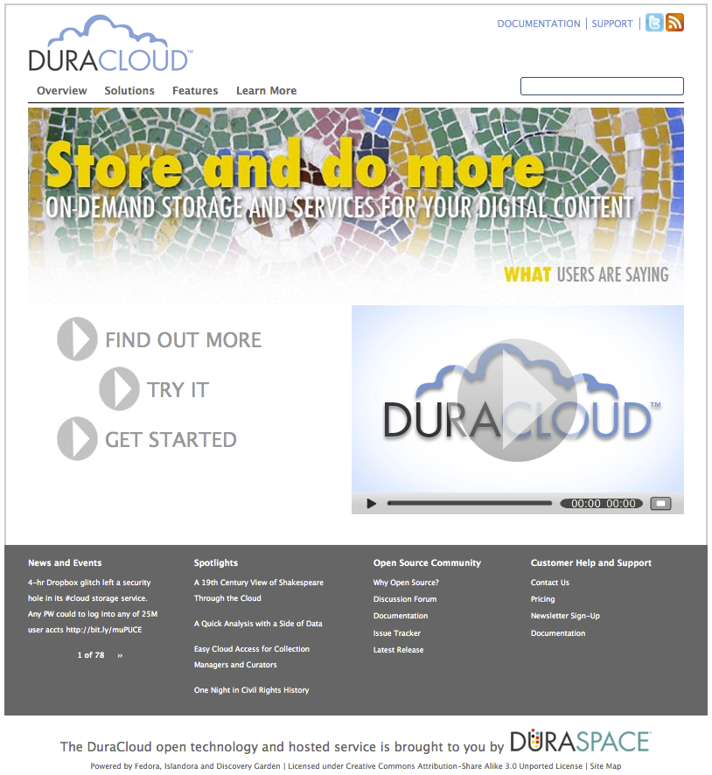
Where can I find out more?
Web site: www.duracloud.org
Email: csmith@duraspace.org
Contact me if interested in a live DuraCloud demo session.

