Slide 1
Archiving and Preservation
Michele Kimpton
CEO, DuraSpace
Bryan Beecher
Director, ICPSR
DuraSpace Webinar
November 2, 2011

Slide 2
DuraSpace Mission
We are committed to providing open source technologies and services that promote durable, persistent access to the scholarly record.

Slide 3
Preservation challenges
Ability to readily provision online storage (ideally in another geographic area, another administration)
Synchronize content across storage systems
Audit integrity of content
Technical resources required
Internal Policies
Sustainability over time

Slide 4
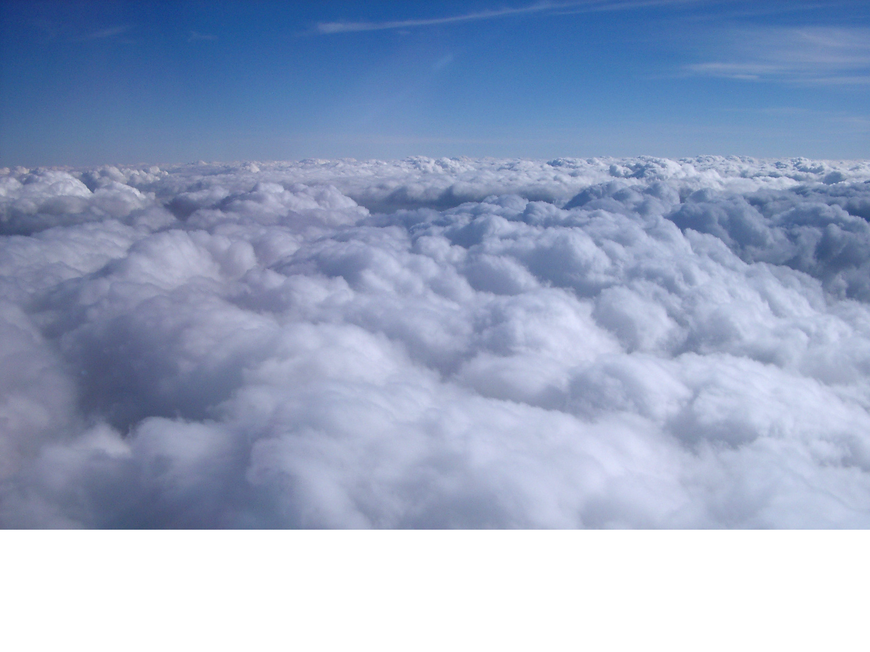
Why cloud?
Massively scalable compute and storage offered as a web based service

Slide 5
Higher Ed survey, 211 responses

Slide 6
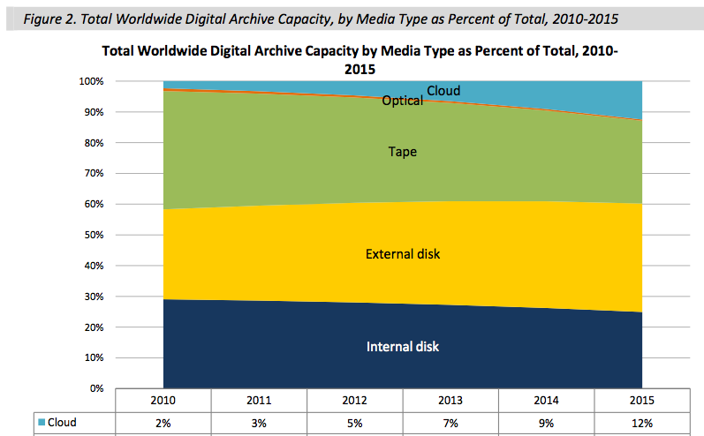
Digital archiving by media type
ESG white paper, Feb 2011

Slide 7
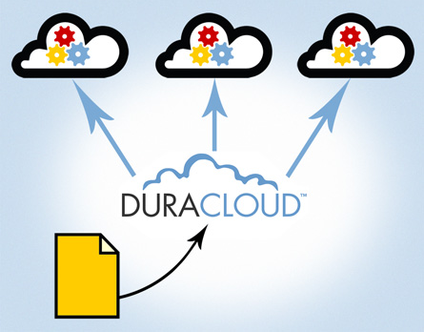
What is DuraCloud?
Platform and service based on cloud infrastructure
Across multiple cloud providers

Slide 8
DuraCloud apps
Archiving and Preservation focused-
Online Backup(s)
File Format
Identification
File health check
Synchronization of content to multiple clouds
…more on the roadmap

Slide 9
Archiving and Preservation support
Duracloud provides
Easy back up to multiple cloud providers
Keep backups in sync
Check health of backups
Ability to view and download files
Retrieve and restore files
Web accessible

Slide 10
Using DuraCloud for Archiving & Preservation
Bryan Beecher
Director, Computer & Network Services
ICPSR

Slide 11
About ICPSR
Inter-university Consortium for Political and Social Research
Located at the University of Michigan
World’s largest archive of social science research data
In operation for 50 years
About $15m in revenues

Slide 12
Archival holdings
Lots of little files
text/plain
application/pdf
text/xml
other stuff
2m files; 6TB of storage

Slide 13
Strategy
Bit-level for original (SPSS + Word)
Normalize into more durable formats (plain text data + XML metadata + PDF/A documentation)
Transform for better delivery
Retain transform and derivatives
Lots of copies

Slide 14
Data archiving, 1 BC

Slide 15
Geographic Diversity, 1 BC

Slide 16
Geographic Diversity, 1 BC

Slide 17
Geographic Diversity, 1 BC

Slide 18
Maybe disk instead of tape?
Synchronize content to other locations
Fixity checking lets us know when we need to “fix” something

Slide 19
Get by with a little help from our friends

Slide 20
And they are friends
Based on relationships
No SLA
No scale up/down
Idiosyncratic interface
Contracts? We don’t need no stinkin’ contracts!

Slide 21
A copy in the cloud

Slide 22
Are you crazy?
FISMA Low
Not encrypted
Machine room open access
Firewalled
Professional IT staff + others
FISMA Medium
Encrypted
Machine room controlled access
Firewalled
Professional IT staff

Slide 23
Honeymoon period
Automated monthly billing for usage (storage, computer, network I/O)
Small EC2 instance + 6 x 1TB EBS volumes bound together as a RAID
Easy to scale up and down
Easy to synchronize

Slide 24
And best of all…

Slide 25
So what’s not to like?
Cloud diversity
Location
Technology platform
Operational processes
Business viability
Vendor lock-in

Slide 26
Who can save us?

Slide 27
What we like
Single interface to “the cloud”
Single billing contact
Single relationship
Value-added services
Fixity checking

Slide 28
What we would change
Filesystem semantics would work better for us
rsync v. synctool
files v. objects
Support for big files/objects
Tools suitable for automated batch use (i.e., out of cron)

Slide 29
Takeaways
Cloud is a viable option for additional archival copies
Physical infrastructure may be at least as good as your own
Encrypt the sensitive stuff
Not the low-cost solution; but may be the low-hassle solution

Slide 30
More info
Bryan Beecher
bryan@umich.edu
http://techaticpsr.blogspot.com/
Thank you for attending this talk

Slide 31
Upcoming DuraCloud Webinars
Technical Overview of DuraCloud November 16 at 1pm ET
DSpace and DuraCloud
November 30 at 1pm ET
Fedora and DuraCloud January 11 at 1pm Et

Slide 32
Try DuraCloud Free for One Month: Trial or Subscription

Slide 33
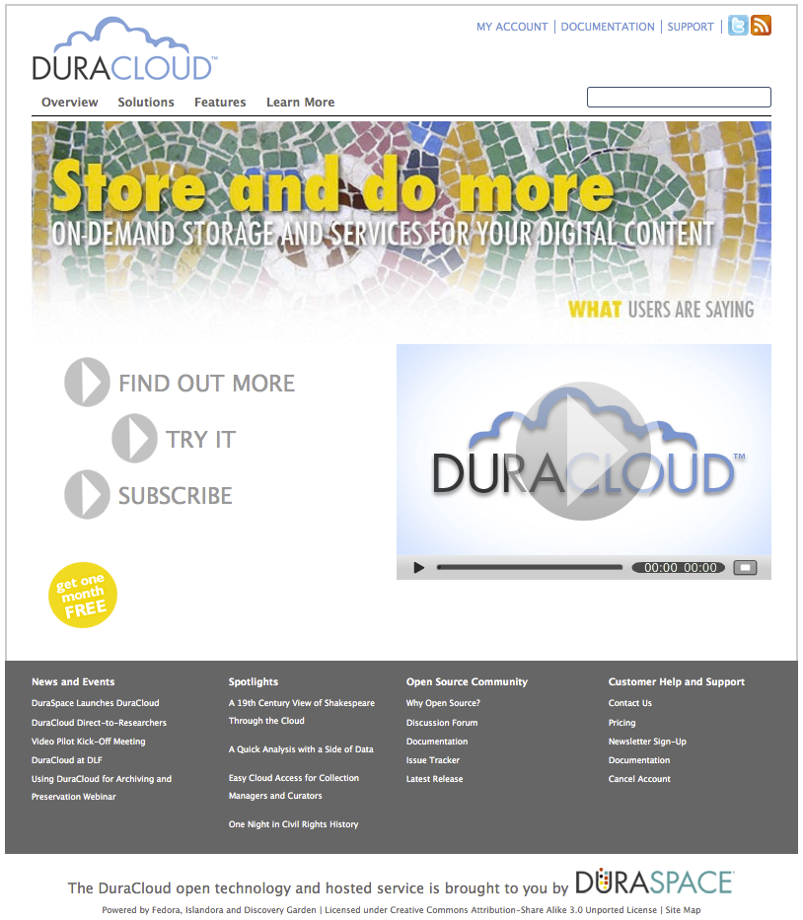
Where can I find out more?
Web site: www.duracloud.org
Email: csmith@duraspace.org

