Slide 1



Hydra Partners Meeting
March 2012
Bill Branan
DuraCloud Technical Lead

Slide 2

Agenda
Introduction
Architecture
Running DuraCloud
Cloud Gotchas
Initiatives
DuraCloud for Research
Integrations

Slide 3

Introduction
DuraCloud is:
  Hosted service
    Runs on cloud-based compute systems
    Connects to cloud-based storage systems
    Provides a service platform
  Open source software suite
Primary Goals:
  Simplify the path to the cloud
  Add preservation sensibilities to the cloud
  Provide a service platform
  Enable a community-based cloud solution
Notes:
Simplify:
Lower the technical barriers
Provide more convenient billing
Limit the number of relationships orgs need to have
Preservation
- Multiple geographies, multiple administrations

Slide 4

Unique URL:
http://yourinstitution.duracloud.org
Organization/Administrator using DuraCloud
Amazon S3
Repository, Content Management System, File System
(via web, REST APIs, utilities)
Rackspace Cloud Files
DuraCloud platform running
on a compute cloud
Programming interfaces
SDSC Cloud
UI
System Administration
API
Storage Management
API
Other Clouds
Reporting & Automation
API
Service Management
Services:
Backup
Health check
Synchronization
Replication

Slide 5
DuraCloud Storage
User Data Center
Amazon S3
Amazon Storage Adapter
REST API
Storage Provider Interface
Rackspace
Cloud Files
Rackspace Storage Adapter
Storage
Mediation
Microsoft Azure Storage
Azure Storage Adapter
SDSC Cloud Storage
Storage Management (DuraStore)
SDSC Storage Adapter

Slide 6
Storage REST Interface
Space Actions
Add Space
Get/Set Space Properties
Get Spaces List
Get Space Content List
Get/Set Space Access
Delete Space
Content Actions
Add Content
Get/Set Content Properties
Get Content
Copy Content
Delete Content
Storage Provider Interface
Other Actions
Get Stores
Get Tasks List
Perform Task

Slide 7
DuraCloud Service Deployment
Deploy
Service
Service Management (DuraService)
1
Service Config
REST API
2
Service Manager
Service Deployment
Retrieve Service Bundle
Deploy Service
4
Service Bundle
Service Config
Service Bundle
Service Registry
Service Container
Service Bundle
Service Bundle
3
Service Configurator
Deployed Service
Deployed Service Config
Service Config
Service Plan

Slide 8

Service REST Interface
Get Services
Deploy Service
Get (Deployed) Service
Get Deployed Service Properties
Update Service Configuration
UnDeploy Service

Slide 9
DuraCloud Instance
Services
DuraCloud Distributed Services
Media Streamer
Duplicate on Demand
Duplicate on Change
Bit Integrity Checker Tools
Bit Integrity Checker
Bit Integrity Checker Bulk
Image Transformer Bulk
Image Transformer
Image Server
Runs on DuraCloud Instance
Connects to DuraStore
Can be direct Java service
Can be deployed web app
Runs primarily outside of DuraCloud Instance
Connects to DuraStore
Makes use of cloud network or computation features

Slide 10
Running DuraCloud
Set of four Java web applications
  Deploy into a servlet container (Tomcat)
OSGi container
  Used to manage DuraCloud services
  Pre-deployed dependency bundles
Initialization
  Connect to loud storage
  Point to apps and services

Slide 11
Cloud Gotchas
Eventual consistency
Server volatility
  Application “state”
  Monitoring
HTTP limitations
Bandwidth limitations
Bit integrity
Storage provider APIs
  Standards?
Notes:
Bit Integrity
- Checksum provided on ingest only, no way to verify later without streaming out

Slide 12
Current Initiatives
Simplification
  Service automation
  Service and storage display integrated
Multi-tenancy
Internet2 Net+ Service
Shibboleth integration
DuraCloud for Research (DfR)

Slide 13
DuraCloud for Research (DfR)
Grant funded by Sloan foundation
Goals
  Encourage the preservation of research data
  Facilitate cooperation between researcher and institutional data managers
  Provide tools and services to support the research process

Slide 14
DfR Priorities
Connect the operational and archival phases of the data management lifecycle.
Create simple workflows across the data management lifecycle that automatically capture metadata and provenance. (…and create incentives for additional metadata creation)
Ensure confidentiality, security, privacy, and predictability of data in the cloud. (Trust and Control)
Automate basic metadata creation and “catalogue” creation.
Create interoperability of operational systems, archiving solutions, and discovery systems used by specific research communities.

Slide 15
DfR Principles
Open source, enterprise software solution
Capture data close to the source
Don’t interfere with researchers’ processes
Provide incentives, added value for metadata creation
Easy to use; workflows for collaboration, hand-off to institution

Slide 16
DuraCloud for Research
Architecture Sketch
DfR System
Fedora Object Creation Service (OCS)
Fedora Repository
Researcher System
Fedora Objects
Fedora UI
Source Data
Search Index
DuraCloud
FOXML
Visual-ization Tools
Space A
RDF
Monitor and Sync Service
Copy of
Source Data
Data Pointers
Space B
Fedora CloudSync Service
Monitor and Sync Settings
Copy of
Fedora Objects

Slide 17

DSpace + DuraCloud
Add-On: Replication task suite
Curation system tasks
AIP packages
  Collection, Community, or Repository
  Multiple formats
Estimate size, Transmit, Verify, Restore, …

Slide 18

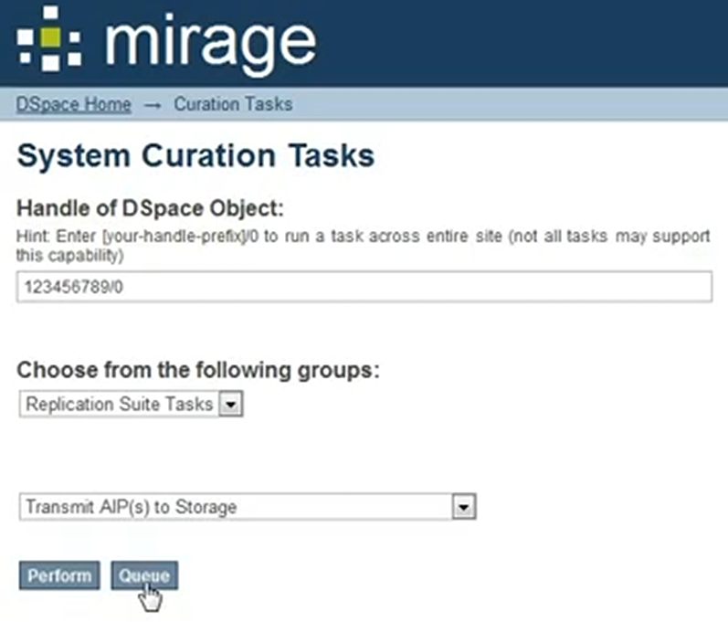
Dspace + DuraCloud

Slide 19
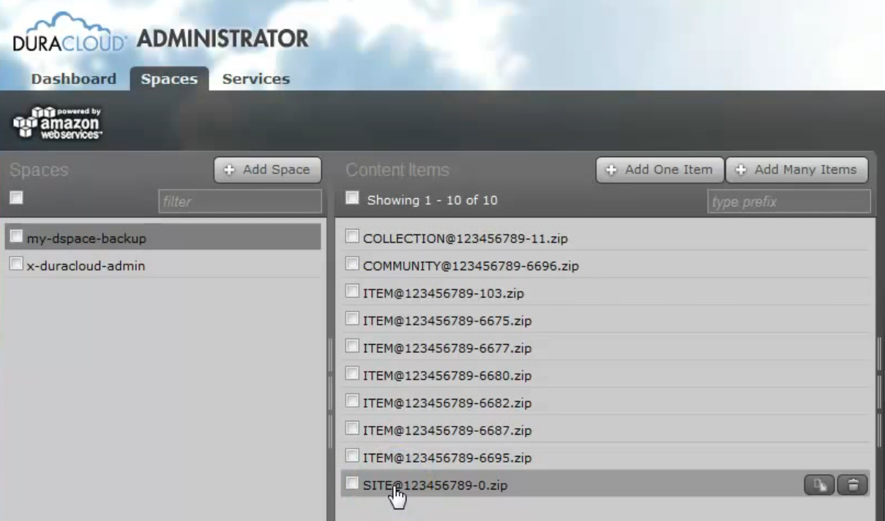
Dspace + DuraCloud

Slide 20
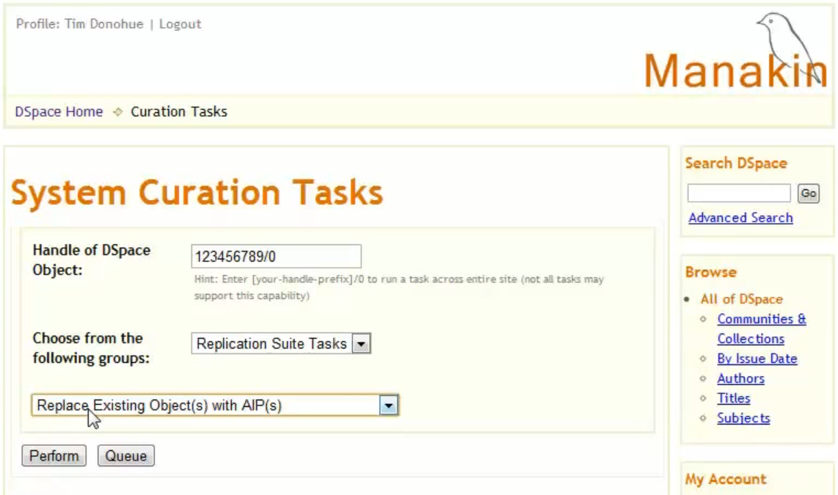
Dspace + DuraCloud

Slide 21
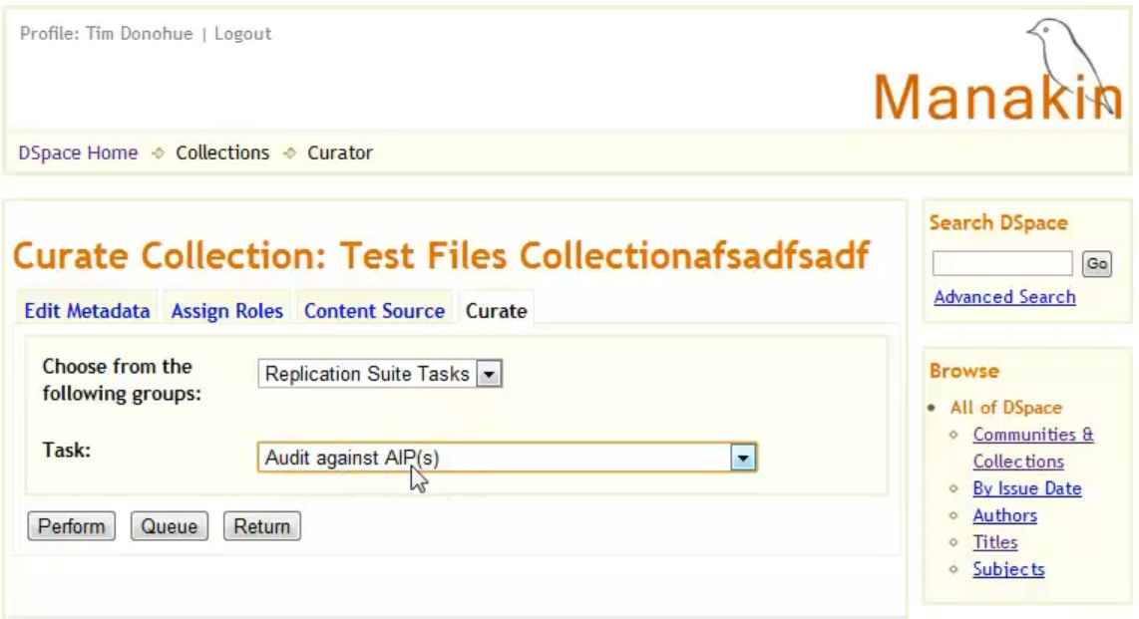
Dspace + DuraCloud

Slide 22

Fedora + DuraCloud
Direct Akubra
Fedora CloudSync
  Point to Fedora
  Point to DuraCloud
  Configure datasets
  Perform Backup
  Perform Restore

Slide 23
Comparison
 | Typical Solution | CloudSync + DuraCloud
Backup Granularity | All Objects | Any Subset
Restore Granularity | All Objects | Any Subset
Skill Level | Advanced | Basic
Downtime | Yes | No
Offsite | DIY | Yes

Slide 24
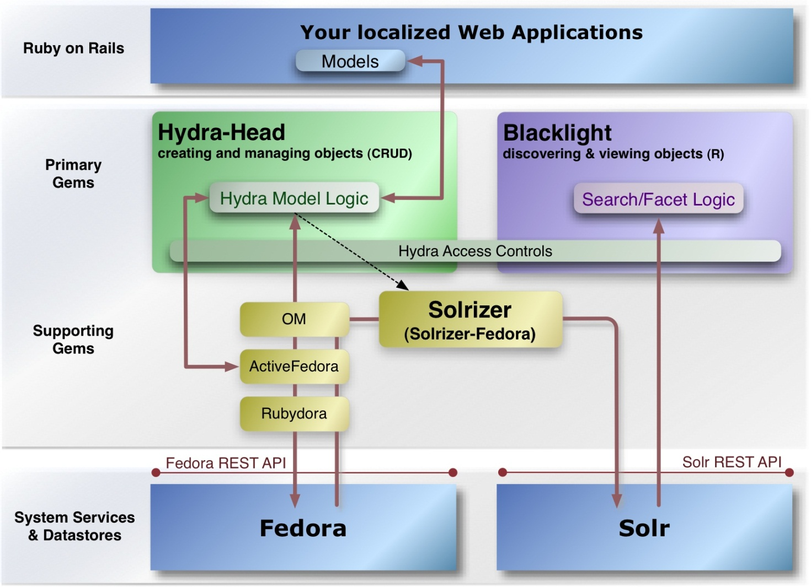
Hydra + DuraCloud
Config
CloudSync
Data
DuraCloud

Slide 25
Hydra + DuraCloud
Ruby DuraCloud Client
DuraCloud

Slide 26
Thank You!
bbranan@duraspace.org

