Slide 1
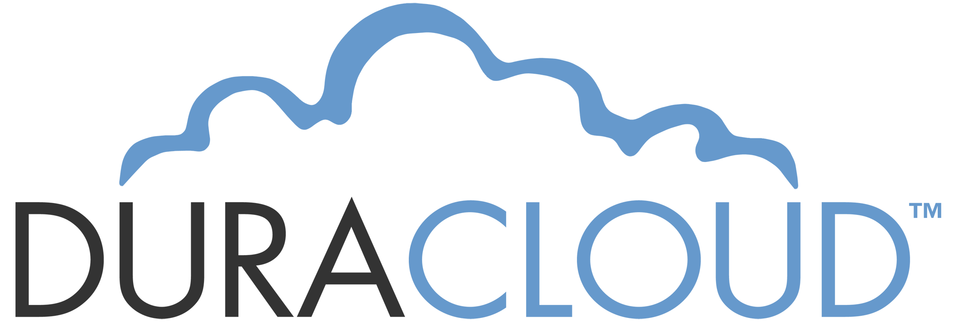
Preserving the scholarly record
Michele Kimpton
CEO, DuraSpace
Stu Baker
Northwestern University
Educause Conference
October 19,2011
Notes:
Today we will be talking about the features and functionality associated with the managed service. DuraCloud software is open source, so if you choose you can run it yourself. We will not talk about the OSS and architecture today however. Joined by Carissa Smith- actual demo

Slide 2
Who are we?

Slide 3
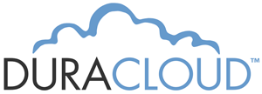
Mission
We are committed to providing open source technologies and services that promote durable, persistent access to the scholarly record.
Notes:
Mission is to provide leadership and support in the development of OS technologies and services that promote durable peristent access to the scholarly record- define the scholarly record- we believe it is the summation of all output from the academic community- ETD’s, journal articles, books, more recently video, audio and data sets.
Our goal is to drive the technologies we support forward to be able to manage and persist a variety of content and to ensure the content can move easily across institutions, technology platforms, and time
Goals is to help our community advance their preservation strategies through technology, services and collaborations.

Slide 4
Preservation challenges
Ability to readily provision online storage (ideally in another geographic area, another administration)
Synchronize content across storage systems
Audit integrity of content
Technical resources
Internal Policies

Slide 5
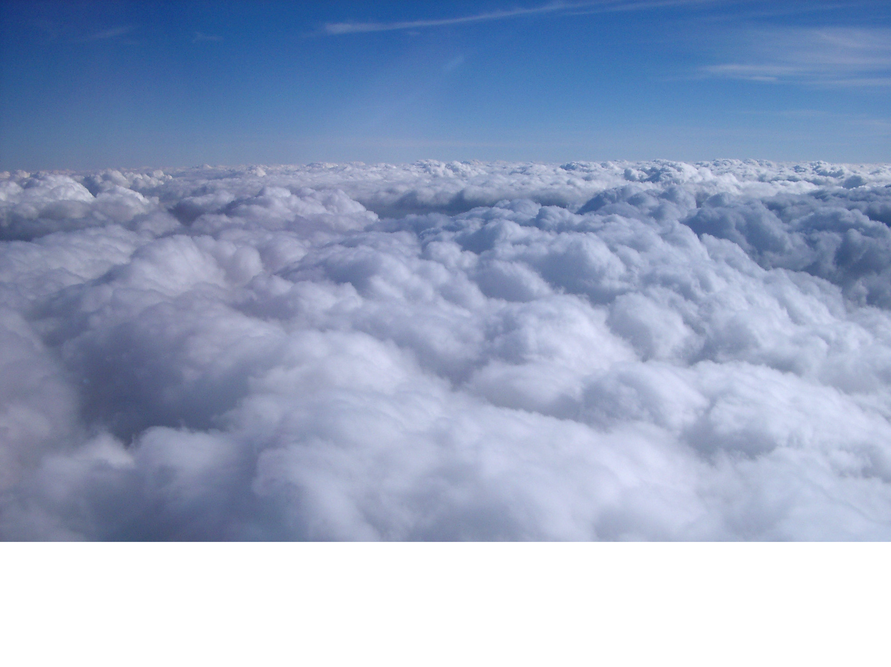
Why cloud?
Massively scalable compute and storage offered as a web based service
Notes:
Easy access to scalable infrastructure
Goal was to build a cloud based platform, that would allow our community to use cloud infrastucture for some of the more challenging tasks- in association with stewarding content

Slide 6
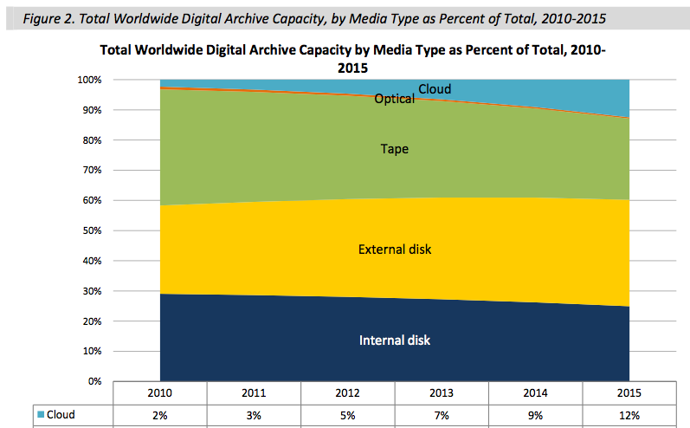
Digital archiving by media type
ESG white paper, Feb 2011

Slide 7
Survey Higher Ed, 145 responses

Slide 8
Survey Higher Ed, 145 responses

Slide 9
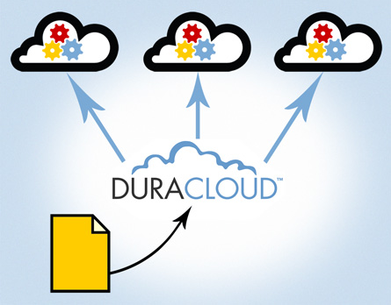
What is DuraCloud?
Digital archiving solution based on cloud infrastructure
Across multiple cloud providers
Notes:
The goal when building the duracloud platform and service was to mitigate the risks of trusting a single cloud provider yet take advantage of the beneifts of being able to scale quickly, only pay for what you need, and have additional services and applications specific to Academia available in the platform, without investing additional technical resources.

Slide 10
DuraCloud apps
Archiving and Preservation
Multimedia Access
Online Backup(s)
Advanced Image Viewing
File Format
Identification
Media Streaming
File health check
Image Transformation
Synchronization to multiple clouds
…more on the roadmap

Slide 11
How does DuraCloud work?
Rackspace
YourDuracloud.org
Virtual server
Amazon S3
(primary)
Content
Transfer Content via:
- Web User Interface
- Sync Utility
-- REST API
Azure (beta)

Slide 12
DuraCloud security Architecture
Notes:
Security is built in at the cloud provider and within the DuraCloud application layer. Firewalls are in place so only http and https access, data is transferred over https, so encrypted over the wire, There is no direct access to your cloud provider account, access is only allowed through the duracloud applications, which as a user authorization layer- and a level of access control. The access to your account in DuraCloud is tightly controlled within our own organization and by the user organization.

Slide 13
DuraCloud Project History
Release 0.5 Open Source
Release
07/2010
.9 release
Beta production
06/2011
Release 0.1 Cloud Storage Mediation
11/2009
.7 release
Bulk services
12/2010
Service Lauch
10/2011
Release 0.3
05/2010
10/2009
Initial Pilot Program Begins
02/2010
Release 0.2
Service Infrastructure
06/2010
Release 0.4
Media Streaming
08/2011
Release 1.0
09/2010
Second Pilot program starts
Notes:
10 releases of the software and ran 2 pilot programs- engaging with 15 partners total to help test the sofware and provide feedback

Slide 14
Pilot Partners
University | Use Case | Repository
Rice U | Preservation | DSpace, meta archive
Hamilton College | Access/international collaboration | Fedora
Northwestern U | Preservation books, audio, image | Fedora
U of PEI | Image access | Fedora/Islandora
ICPSR | Preservation | Fedora
IUPUI | Preservation | DSpace, Content DM
Rhodes College | Image Access | DSpace
North Carolina State U | Preservation | DSpace
CARL | Preservation and Services | Fedora
MIT | Preservation | Dspace
Columbia | Preservation and Services | IA, Fedora

Slide 15
Use cases explored
Digital archiving
Video streaming
Data management
Image serving
Collaboration
Notes:
Online archiving, media streaming and access, collaboration, cloud brokering
We started at the beginning of the pilot exploring all of these use cases, in phase 2 we narrowed our focus to digital archiving a preservation as there was a strong interest- and of highest prioritySo for the sake of the pilot and initial launch this is what we have decidded to focus on. Functionality is there for the other use cases, it might not be as full featured though at this stage and we have projects in place now to build out those use cases

Slide 16
Archiving and Preservation support
Requirements met
Easy back up to primary and secondary cloud
Keep backups in sync
Check health of backups
Ability to view and download files
Retrieve and restore files
Web accessible

Slide 17
On the roadmap
Services/Apps
Improved video handling
File validation
Encryption
Storage providers
SDSC Cloud
Azure
Local Eucalyptus integration
Simplification

Slide 18
Key Findings from Pilots
Biggest challenge was transferring data from content owner
Extremely difficult to compare costs
Integration with local systems
Biggest value of DuraCloud was simplicity and abstraction of individual cloud stores

Slide 19
Pilot partner comments
“The ease-of-use of DuraCloud is its most impressive feature.” ~Columbia
“DuraCloud delivers the benefits of a diverse network of storage locations, but without the overhead of managing different vendors.” ~ICPSR
“One of the best things that DuraCloud does is bridge the complex gap between normal users and cloud-based services, and it does this job very well.” ~Rhodes College

Slide 20
What we learned about the cloud
Durability- No loss of data over 2 year period, 15+ accounts, 15+ TB BUT no published SLA or policy
Eventual consistency
Data transfer rates over http, 1 GB realistic
Large file handling evolving- 5 GB chunk size
Verification of content via check sum depends on provider
No standard API’s yet across providers
Instability of cloud providers ( Atmos,Sun)

Slide 21
Reaching for the Cloud
EDUCAUSE 2011
Stu Baker
stubaker@northwestern.edu
Notes:
Glad to be here to talk to you about what is going on at Northwestern and the Library
I had to come up with the requisite “cloud” title -- so there it is. NEXT SLIDE

Slide 22
On the docket
Northwestern’s computing environment
Digital Preservation Strategies
Duracloud pilot
Cloud Challenges
Notes:
Talk about our computing environment
Emerging Digital Preservation strategies – motivators for the strategy and benefits to a cloud based approach
Duracloud Pilot – what we did as a pilot partner and what we see happening moving forward as part of our strategy
Cloud Challenges – cloud services and storage hold promise, but there a few challenges to contend with.

Slide 23
NORTHWESTERN UNIVERSITY LIBRARY
4,930,613 Books
208,757 Maps
601,153 Images
66,977 Audio
33,882 Film and video
98,844 Journals and serials
22 TB Unique digital content
84 Web sites
750 Workstations
59 Servers
Notes:
NU Distributed IT infrastructure
Enterprise systems all at the data center including Fedora repository
Library allocated 16 Tb replicated storage centrally per year; we requested for 100Tb replicated …
All storage is disk based, traditional backups, off-site tape storage, replication
Curatorial storage solution not yet available. There are no Digital Preservation solutions in place

Slide 24
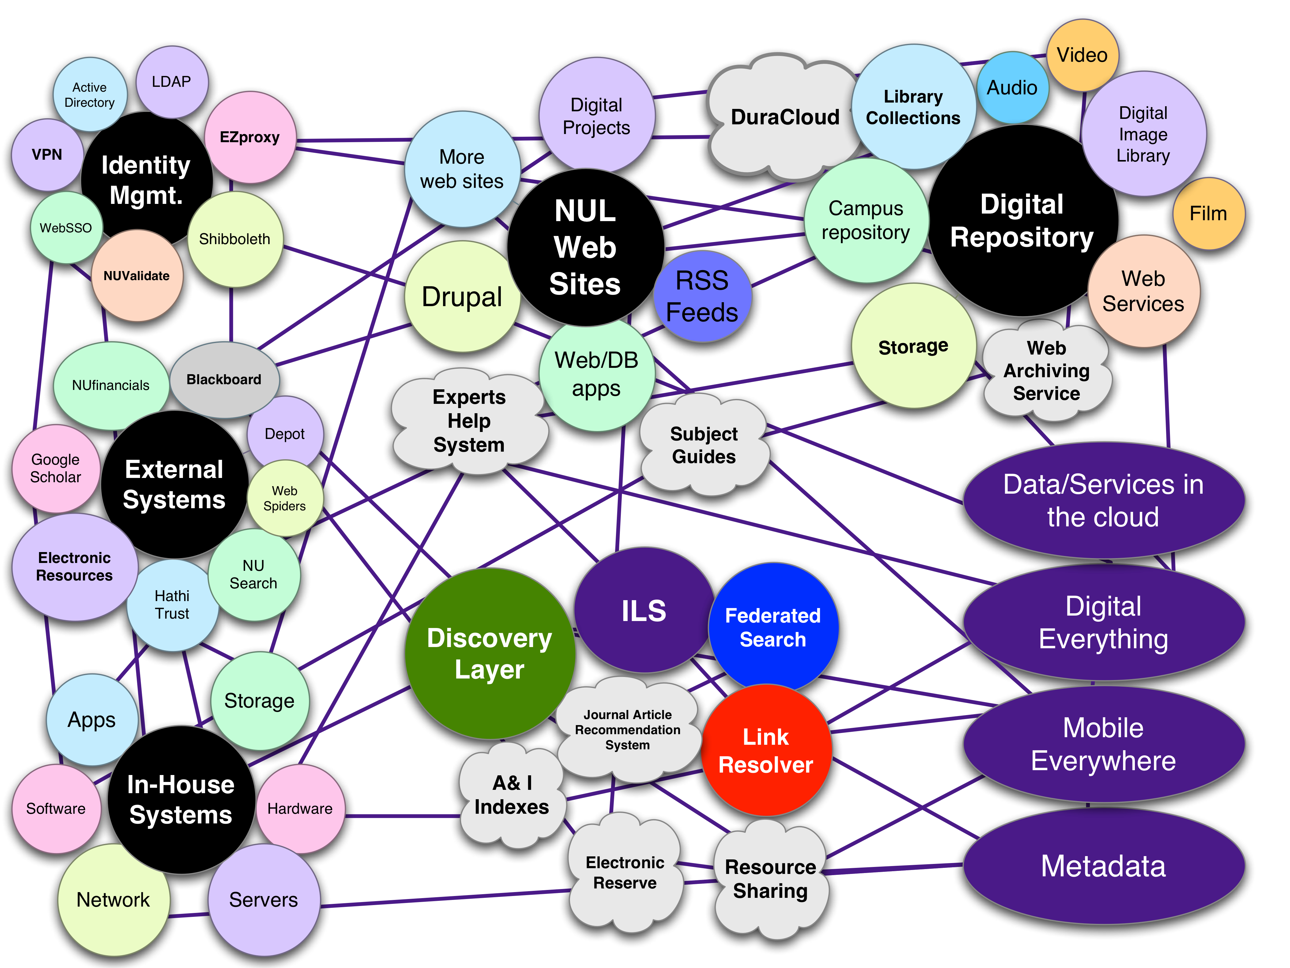
Notes:
DATA Services in the cloud
Digital Everything
Mobile Everywhwere
Metadata
WEB, REPO, LMS strategically moving to cloud services for several years. Moving to cloud storage seemed like a natural
Challenges in integrating the complex WORKFLOWs and systems to get the information and data into a neat package.
We only have 22TB of unique digital content online
Digital Everything – PRONOM Technical Registry currently list 820 different file formats
Expect growth to increase significantly:
Research data, Images, Audio and Video content exploding
Film and Audio reformatting projects in the wings

Slide 25
Moving towards a strategy
Preservation risk assessment, metadata extraction, format migration planning, object identification and validation
Digital Preservation Services and Workflow
Scalable Architecture
Hybrid storage strategy
Re-allocation of staff expertise and local technology
Notes:
Conferences always a good sanity check. Think we are far behind and realize most institutions are grappling with the same issues.
A good digital preservation strategy should include all of the things listed in the first bullet.
Best practices and frameworks such as OAIS exist but you still have to build or buy technology to execute the plan
Shared infrastructure - storage layer that works with preservation services which support unique WORKFLOWs
Have to Integrate those services with Open Source or Vendor provided products.
Scalable – want to buy in incrementally while we get a better handle on growth rates for campus content
Hybrid – campus solutions for local curatorial storage are still being formulated.
Need something now to CYA or “Cover your assets”
Need Service that was easy to use so NON IT STAFF could manage the oversight of the system, free up IT staff and repurpose some local storage
HOW DOES DURACLOUD Fit into the PRESERVATION strategy ?

Slide 26
DuraCloud pilot
Dark archive
Locally digitized books
Fedora repository
For a 300 page book:
300 camera jpegs
300 edited jpegs
300 jp2s
300 pdfs
300 OCR txt file
300 OCR XML files
Notes:
So we saw Duracloud as a way to address some of our strategic goals
Worked with like minded community for many years. We are also part of a repository development community called the Hydra project that is trying to tackle many of these digital preservation issues
MOTIVATION: trying to figure out how the cloud might work for us, the pilot seemed like an ideal way to start
USE CASE: Dark Archive for books
Used books in pilot because they were the most dynamic in terms of workflow and had large number of data streams
What we did
Baseline Sync tools, tested APIs
FEDORA transfer to Cloud and selective restore and rebuild
Preservation Monitoring test
What did we learn PILOTwas Overall success,
DuraCloud Dashboard was easy to use -- NON IT STAFF managed a lot of the work on the pilot
Has potential for building a suite of services that support our digital preservation strategies and workflows
Scalable architecture and geographically diverse
Identified some use cases that were important to us that were subsequently addressed in a later release.
It really helped us understand the challenges and issues that lie ahead.
Speaking of challenges…next slide

Slide 27
Cloud Challenges
Service Provider Security Assessment
Addressing PII, PHI, or other sensitive data concerns
More sophisticated access control provisions
Determining lifecycle costs for preservation; Consortial deals?
Tiered mass storage strategy; How far do we go?
Notes:
SPSA - Why was this put in place, (Security practices, Data Protection, Architecture
Was difficult to fill out the security assessment given we are running our platform on Amazon and not our own data center. Look at the combined software stack running on amazon and took their best shot.
Many of the types of certifications and protocol the survey asked for Amazon does not provide and most likely will probably never provide, as it would be too costly and inflexible for them to follow.
Need to make sure to provide segragated storage for PCI and HIPAA data
Access Control big issue for us. Need better support for Federated IdM so we can tie into our provisioning systems and support collaborative research using digital content.
Lifecycle costs (LIFE Project in UK) can be calculated but there a lot of factors to weigh
We are still trying to determine TCO of a cloud storage solution vs traditional tapes, disk.
Suggestion: Look to consortial deals and partnerships with industry
Will the cloud give us everything? convenience, cost, reliability scalability, service and incident management.
CURRENTLY 3% of archival storage in the cloud anticipate 15% or higher by 2015
SDSC's Cloud Storage, Metaarchive, Chronopolis
THANK YOU

Slide 28
Upcoming Webinars
Using DuraCloud for Archiving and Preservation November 2nd at 1pm ET
Technical Overview of DuraCloud November 16th at 1pm ET
DSpace and DuraCloud integration
Fedora and DuraCloud integration November/December days/times TBA

Slide 29
Free DuraCloud Trial Accounts

Slide 30
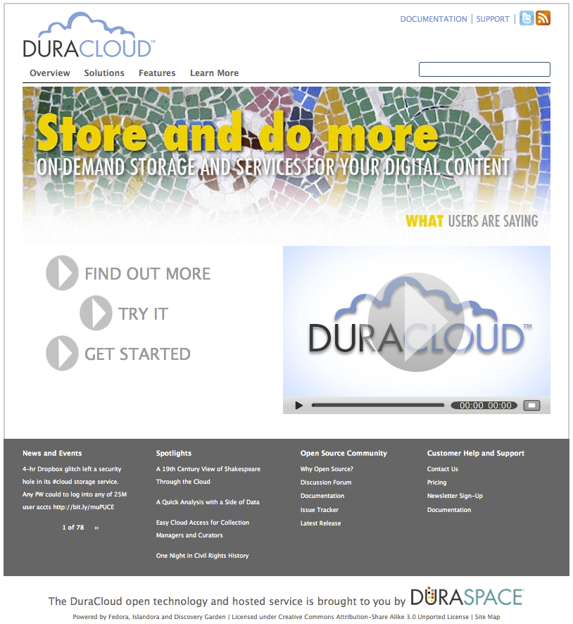
Where can I find out more?
Web site: www.duracloud.org
Email: csmith@duraspace.org

Slide 31
The open source platform
Available for organizations to run locally
Requires cloud ( commercial or private) infrastructure
Being tested by several organizations now
Looking for organizations that want to enable their “software as a service” in DuraCloud
For more details visit the wiki at:
https://wiki.duraspace.org/display/duracloud/

